Slide 1

Low-frequency Strategy with Efficient Frontier
Group 1: YU Lingfeng, Kendrick Winata, Najwa Jia Hui Rujok, Jennifer Claudia Gozal, June Yap Chou Yeng, YIN Shanshan

Slide 2
Content
Introduction
Data description
Strategy evaluation Methodology
Strategy tuning
Portfolio construction
Conclusion

Slide 3
Introduction
Project objective: Improved sector allocation strategy with efficient frontier
Basic strategy: minimise variance or maximise Sharpe
Apply the basic strategy in different periods: pre-covid, covid, post-covid
Add-on 1 Extension: extend the training period
Add-on 2 Rolling: rolling windows with different rebalancing frequencies and training periods
Add-on 3 Diversification: include more sectors to diversify the portfolio
Add-on 4 Shorting: allow shorting of different extent
Add-on 5 Risk Management: risk control using VaR at different timing and periods
Develop an improved strategy with choice of add-ons and their specs

Slide 4
Data Description
Data: daily portfolio returns of 5, 10, 17 and 30 US industries from Ken French’s data library
Training/In-sample period: pre-covid (bef. 2020-01-01)
Testing/Out-of-sample period: covid & post-covid (2020-01-01 to 2024-04-1)
Derived data column 1 “Ret”: % change of daily returns
Derived data column 2 “PnL”: 1+ cumulative “Ret” for calculating VaR

Slide 5
Strategy evaluation
Efficient frontier on the 10 US industries dataset
Minimizing risk vs maximizing return
In-Sample Performance
Out-of-Sample Performance
Value at Risk
Performance Comparison

Slide 6
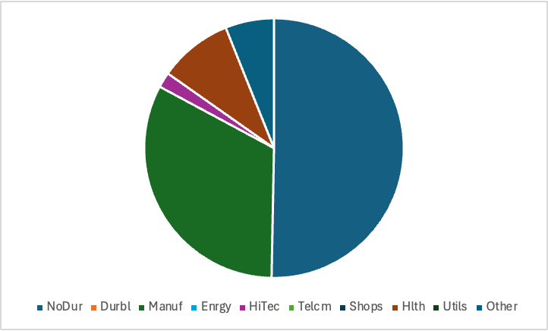
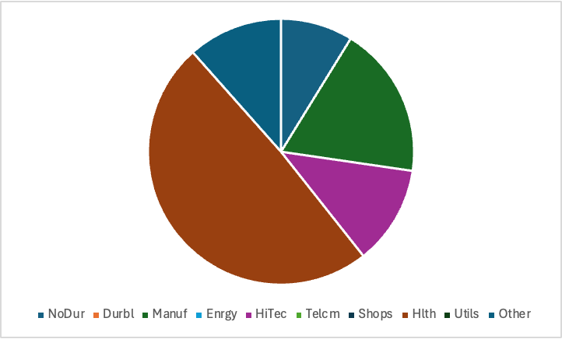
Efficient Frontier
Minimizing Risk
Maximizing Return
Return | 12.5%
Standard Deviation | 11.79%
Sharpe | 1.06
Return | 14.42%
Standard Deviation | 12.677%
Sharpe | 1.14

Slide 7
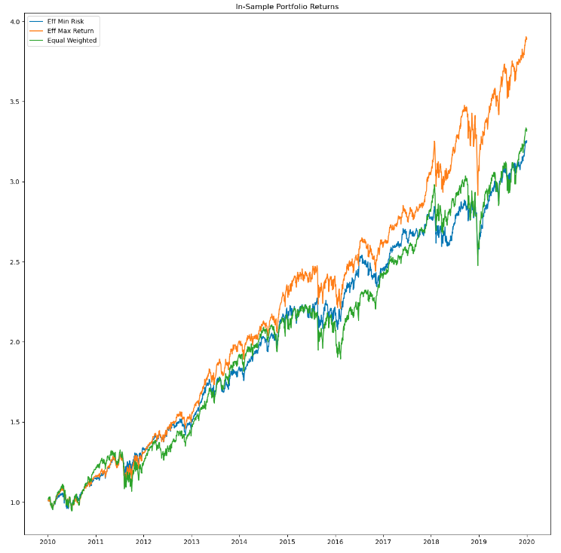
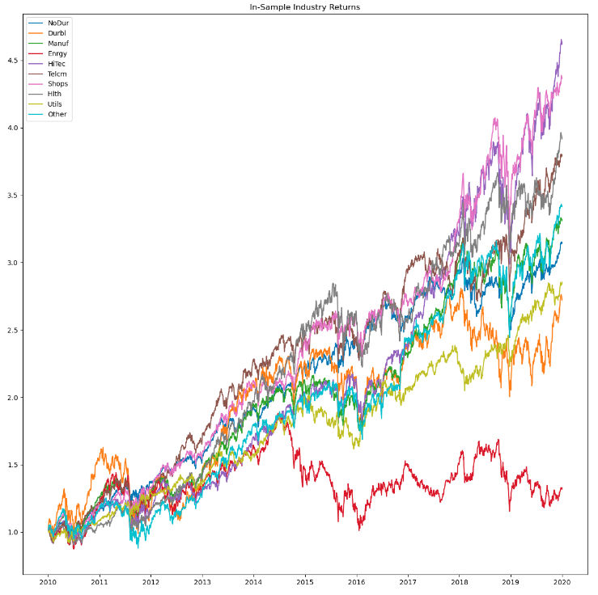
In Sample Result

Slide 8
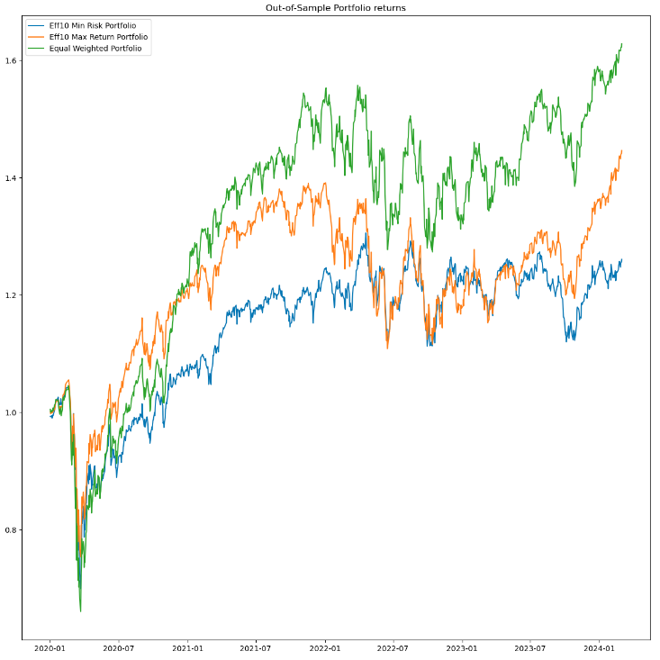
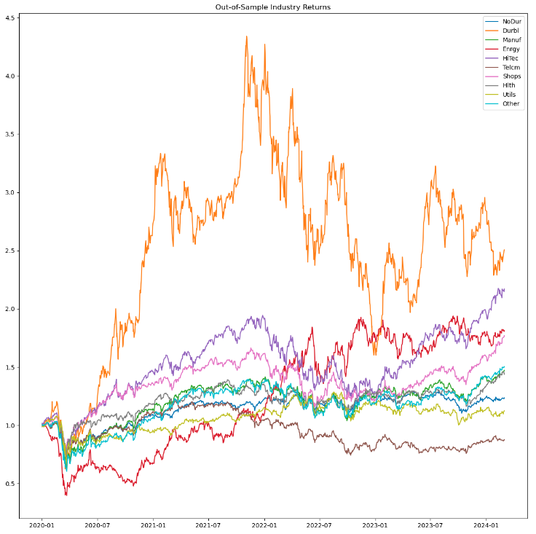
Out of Sample Result

Slide 9
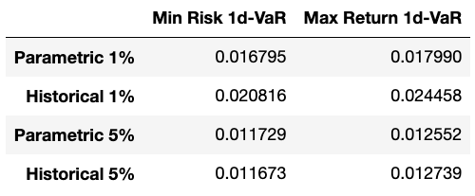
Value at Risk
We are calculating the Value at Risk to quantify our risk by implementing this strategy. We measure both 95% & 99% VaR using Parametric method and Historical method

Slide 10
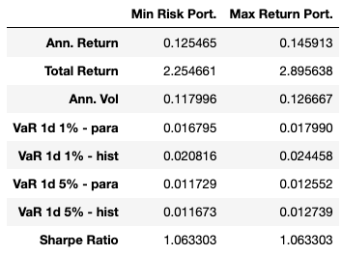
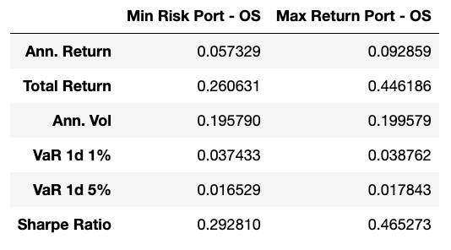
Performance Metrics
In Sample
Out of Sample

Slide 11
Strategy Tuning – start, end , bounds
Extension of Training Period
Rolling Window
Diversity Effect
Shorting Effect
Risk Management

Slide 12
Strategy Tuning – Historical Data
Extend Historical Data Usage (1990-2010): Utilize extended historical data to calculate optimal portfolio weights, ensuring robustness in varying market conditions.
Generate In-Sample Performance Metrics: Use the efficient frontier to derive minimum risk and maximum return portfolios, evaluating performance metrics like returns and volatility within the sample period.
Generate Out-of-Sample Performance Metrics: Assess the generalizability of the in-sample optimized portfolios by evaluating their performance metrics in out-of-sample periods.
Adjust Portfolio Weights: Continuously adjust and align portfolio weights based on historical performance trends to ensure smooth transition from training to testing phases.
Evaluate Risk and Return Profiles: Incorporate risk assessments such as Value at Risk (VaR) to evaluate the potential for losses under normal and extreme market conditions in both in-sample and out-of-sample analyses.
Comparative Analysis: Compare performance metrics between portfolios constructed using different historical data periods (e.g., 1990-2010 vs. 2010-2020) to understand the impact of varying market conditions on portfolio performance.
Refinement and Optimization: Refine the investment strategy based on feedback from out-of-sample testing to enhance future portfolio resilience and performance.
Notes:
Generating Weights for Efficiency Frontier:
This involves using historical data (from 1990 to 2010) to calculate optimal portfolio weights that aim to either minimize risk or maximize returns. The methodology applies constraints like weights summing to 1 and each weight falling within the 0 to 1 range.
Constructing Holding Weights:
The strategy constructs weights for the portfolio using in-sample dates to ensure continuity in the transition from the training period's end. This essentially helps in managing and adjusting portfolio holdings based on historical performance.
Establishing In-Sample Daily Performance:
The approach calculates daily returns for portfolios with weights geared towards minimizing risk and maximizing returns. This step uses the previously determined weights for performance evaluation.
Consolidation of In-Sample Performance Metrics:
This step consolidates various performance metrics like annualized returns, total returns, and volatility. It also includes risk assessments through Value at Risk (VaR) measures, comparing portfolios constructed with different historical data ranges to assess their performance over the selected periods.
Comparative Analysis:
A comparison of efficient frontiers generated using different historical data sets (1990-2010 vs. 2010-2020) highlights the impact of market trends on portfolio performance, indicating that more recent data tends to yield higher returns and risk, reflecting a shift towards potentially more aggressive investment strategies.
In summary, this methodology expands the training period in a portfolio optimization context to adapt to market changes over time, employing historical data to refine investment strategies according to the observed performance metrics and risk assessments.

Slide 13
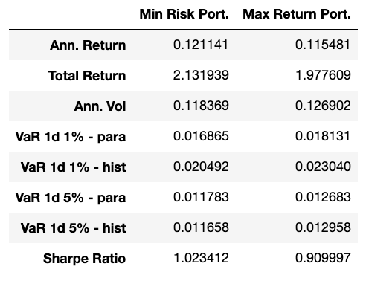
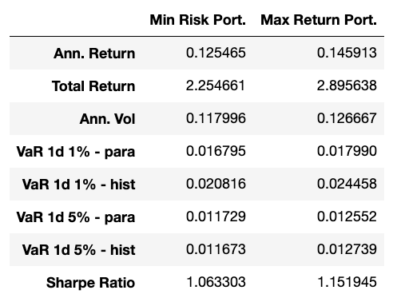
Strategy Tuning – Historical Data
In – Sample Period Performance Metrics
New efficient frontier (historical data 1990-2010)
Original efficient frontier (historical data 2010-2020)
The data indicates that the more recent historical data (2010-2020) tends to create portfolios with higher returns and slightly higher risk, reflecting recent market trends and possibly a more aggressive investment approach.
Conversely, using older historical data (1990-2010) results in more conservative portfolios with lower risk and returns, which could be preferable for investors prioritizing stability over high returns.
These differences underscore the importance of selecting appropriate historical periods for portfolio optimization, as they can significantly impact performance metrics and risk management outcomes.
Notes:
New Efficient Frontier (1990-2010):
Exhibits generally lower annual returns compared to the original efficient frontier (2010-2020).
Shows less volatility in the Minimum Risk Portfolio but slightly higher volatility in the Maximum Return Portfolio than the counterpart from the later data period.
Total returns are notably lower for both portfolios when compared to those from the 2010-2020 data set.
Demonstrates more conservative risk management, as indicated by lower VaR values across both portfolios.
Original Efficient Frontier (2010-2020):
Achieves higher annual returns and total returns across both portfolios, suggesting a more aggressive or optimized investment strategy based on more recent market behaviors.
Has slightly higher volatility, which correlates with the increased returns, indicating a trade-off between risk and return.
The higher VaR values reflect a greater acceptance of risk, possibly due to more recent market dynamics considered in the model.

Slide 14
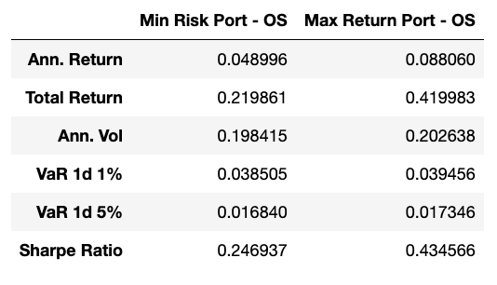
Observation – Historical Data
Out - Of – Sample Period Performance Metrics
New efficient frontier (2020-2024)
Original efficient frontier (2020-2024)
The performance metrics generally suggest that portfolios constructed with more recent historical data (2010-2020) tend to yield higher returns but also exhibit slightly higher risk, as evidenced by total returns and annualized volatility.
The more conservative risk profile (lower VaR) of the new efficient frontier using older data (1990-2010) highlights the influence of different market conditions captured in each data set.
These comparisons demonstrate the significant impact that the choice of historical data period can have on the performance of financial models, particularly in terms of how well they reflect current market dynamics and investor objectives.
Including more history does not necessarily improve performance
Need to balance relevance and effectiveness

Slide 15
Strategy Tuning – Rolling Window
Dynamic Window Configuration: Utilize rolling windows of varying sizes (7, 9, 11, 12 months) and multipliers (1, 2, 4, 5) to continuously adapt portfolio strategies based on evolving market data.
Rolling window size dictates how much historical data is considered at one time for analysis. A 7-month window would analyze 7 months of data at a time, then move forward to the next set of 7 months, and so forth.
Multipliers determine the step size in terms of the window's own unit. For example, a window size of 9 months with a multiplier of 5 would mean that after analyzing the first 9 months, the next window starts 45 months later (9 x 5). This setting allows for evaluating how investment strategies perform under different data sampling rates and over different historical periods.
Evaluate Out-of-Sample Robustness: Test the robustness of the in-window optimized portfolios by extending the analysis to out-of-sample periods, ensuring strategies hold under different market conditions.
Risk Assessment Through VaR: Employ Value at Risk (VaR) calculations to gauge potential losses in portfolios across various windows and settings, enhancing risk management.
Comparative Window Analysis: Analyze how different window configurations impact portfolio performance, identifying optimal settings for various market conditions.
Notes:
Generating Weights for Efficiency Frontier:
This involves using historical data (from 1990 to 2010) to calculate optimal portfolio weights that aim to either minimize risk or maximize returns. The methodology applies constraints like weights summing to 1 and each weight falling within the 0 to 1 range.
Constructing Holding Weights:
The strategy constructs weights for the portfolio using in-sample dates to ensure continuity in the transition from the training period's end. This essentially helps in managing and adjusting portfolio holdings based on historical performance.
Establishing In-Sample Daily Performance:
The approach calculates daily returns for portfolios with weights geared towards minimizing risk and maximizing returns. This step uses the previously determined weights for performance evaluation.
Consolidation of In-Sample Performance Metrics:
This step consolidates various performance metrics like annualized returns, total returns, and volatility. It also includes risk assessments through Value at Risk (VaR) measures, comparing portfolios constructed with different historical data ranges to assess their performance over the selected periods.
Comparative Analysis:
A comparison of efficient frontiers generated using different historical data sets (1990-2010 vs. 2010-2020) highlights the impact of market trends on portfolio performance, indicating that more recent data tends to yield higher returns and risk, reflecting a shift towards potentially more aggressive investment strategies.
In summary, this methodology expands the training period in a portfolio optimization context to adapt to market changes over time, employing historical data to refine investment strategies according to the observed performance metrics and risk assessments.

Slide 16
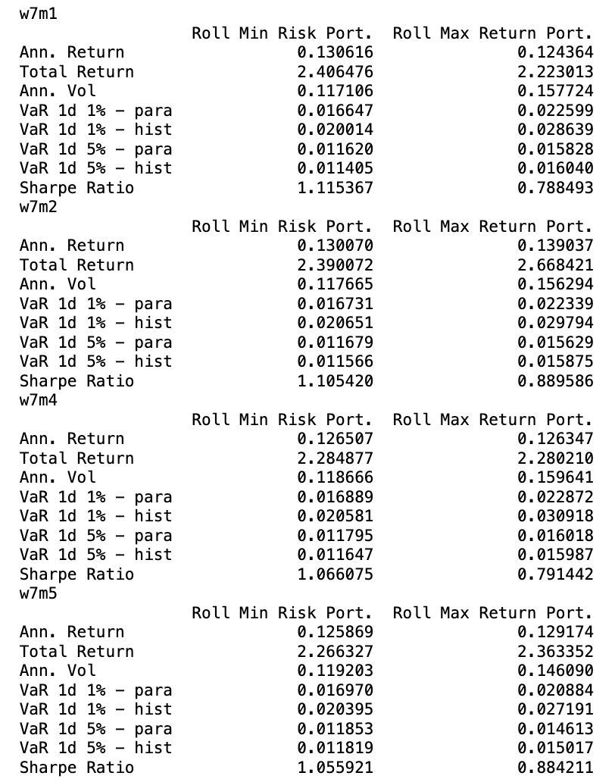
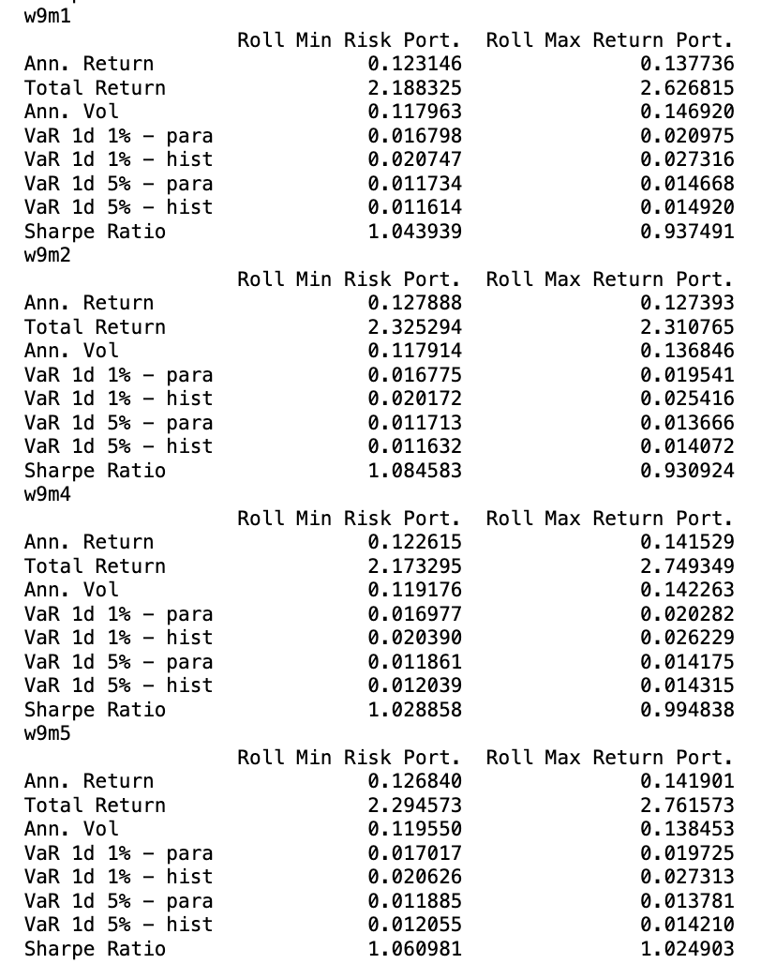
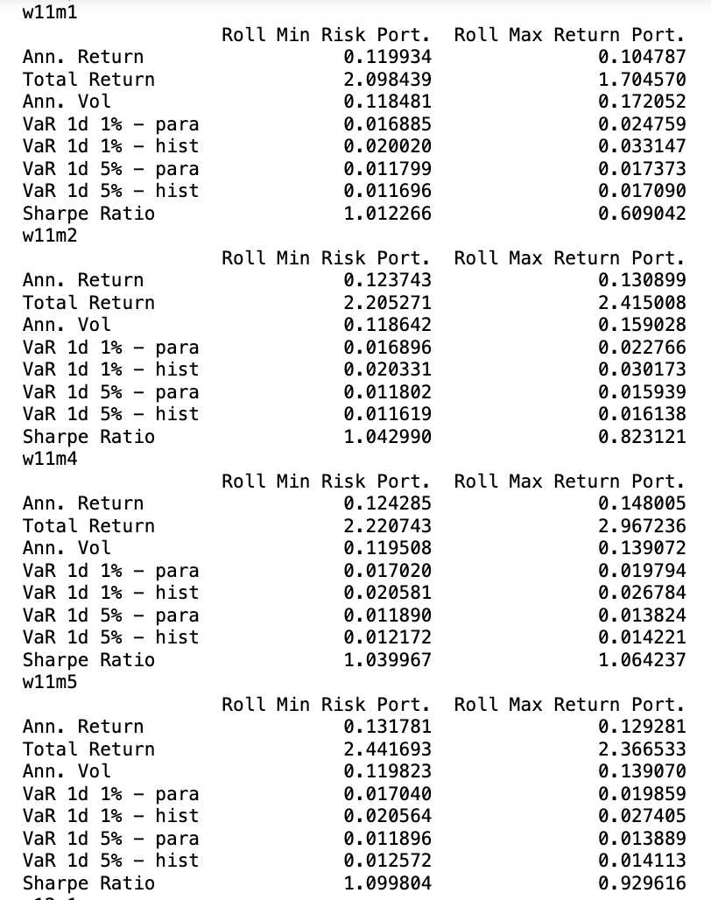
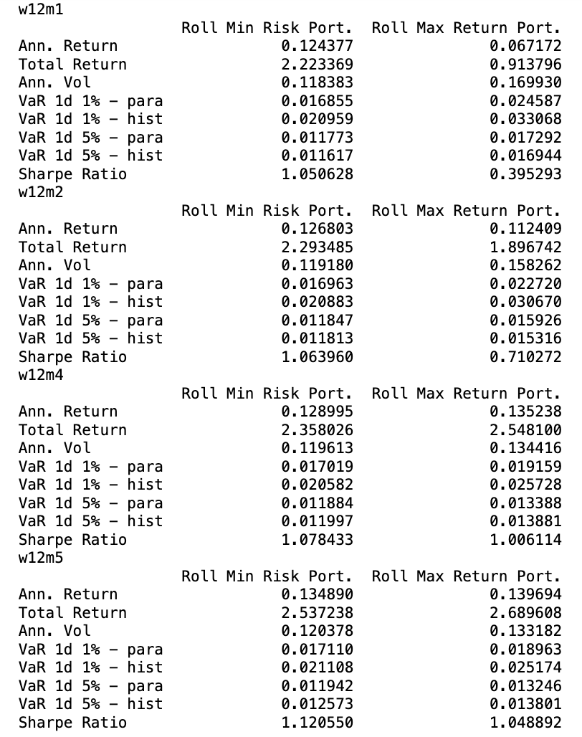
Observation – Rolling Effects
More frequent rebalancing may not necessarily generate good result
Max Return portfolio may not necessarily give higher return than Min Risk portfolios, maybe due to strategy crowdedness, or market regime characters
Rolling window of 12m deemed to be a very crowded strategy, and thus the result is not as good
Some good result combinations :
rebalancing 9 months with 5 times prior window
rebalancing 11 months with 4 times prior window
rebalancing 7 months with 2 times prior window
Notes:
Generating Weights for Efficiency Frontier:
This involves using historical data (from 1990 to 2010) to calculate optimal portfolio weights that aim to either minimize risk or maximize returns. The methodology applies constraints like weights summing to 1 and each weight falling within the 0 to 1 range.
Constructing Holding Weights:
The strategy constructs weights for the portfolio using in-sample dates to ensure continuity in the transition from the training period's end. This essentially helps in managing and adjusting portfolio holdings based on historical performance.
Establishing In-Sample Daily Performance:
The approach calculates daily returns for portfolios with weights geared towards minimizing risk and maximizing returns. This step uses the previously determined weights for performance evaluation.
Consolidation of In-Sample Performance Metrics:
This step consolidates various performance metrics like annualized returns, total returns, and volatility. It also includes risk assessments through Value at Risk (VaR) measures, comparing portfolios constructed with different historical data ranges to assess their performance over the selected periods.
Comparative Analysis:
A comparison of efficient frontiers generated using different historical data sets (1990-2010 vs. 2010-2020) highlights the impact of market trends on portfolio performance, indicating that more recent data tends to yield higher returns and risk, reflecting a shift towards potentially more aggressive investment strategies.
In summary, this methodology expands the training period in a portfolio optimization context to adapt to market changes over time, employing historical data to refine investment strategies according to the observed performance metrics and risk assessments.

Slide 17
Strategy Tuning – Diversity Effect
Objective: The strategy aims to examine how varying degrees of industry diversification impact portfolio performance under different market conditions.
Analysis Scope:
Portfolio Diversity: Analyzes the performance of portfolios diversified across different numbers of industries, specifically 5, 10, 17, and 30, to assess how diversification affects financial outcomes.
Performance Metrics:
Metrics Calculated: Determines key performance indicators such as annualized returns, total returns, sharpe ratio, volatility, and Value at Risk (VaR) for each level of industry diversification. This analysis helps in understanding the trade-offs between risk and return associated with varying diversification levels.
Notes:
include sharpe ratio for all table.

Slide 18
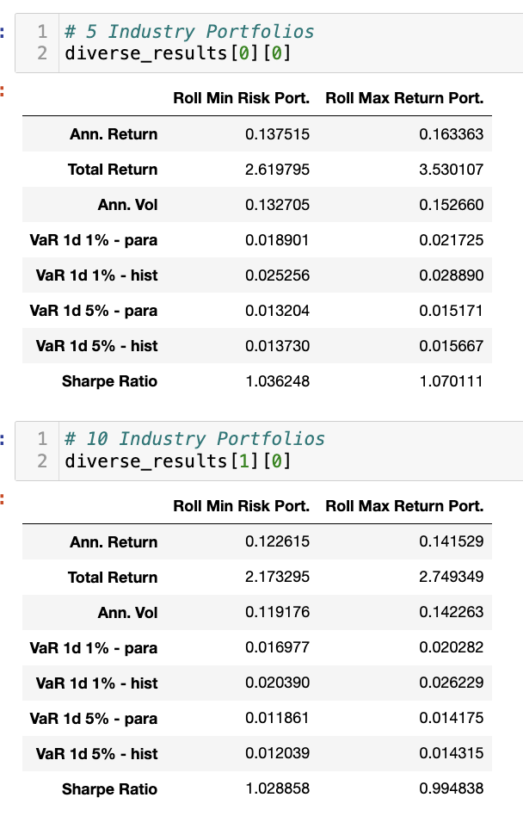
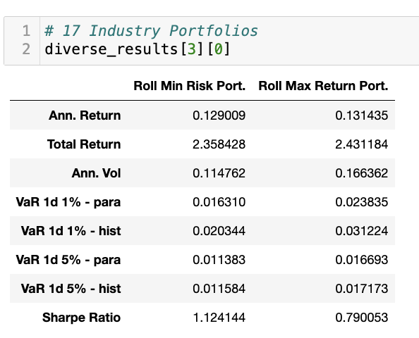
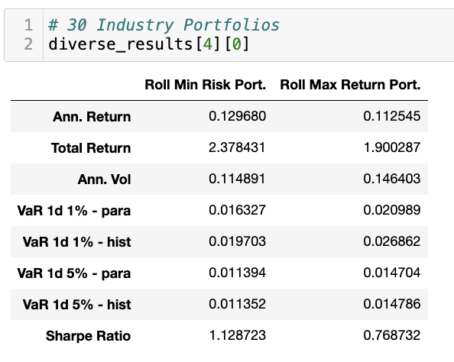
Strategy Tuning – Diversity Effect
Notes:
include sharpe ratio for all table.
Remove 12?

Slide 19
Observation – Diversity Effect
Reduction in Volatility: As the number of industry portfolios increases from 5 to 30, there is a consistent decrease in both annual volatility and the values of Value at Risk (VaR) metrics across portfolios. This trend illustrates that greater diversification across different industries effectively reduces the portfolio's overall risk.
Impact on Returns: There is a nuanced impact on returns. While the total return slightly decreases as the number of industries in the portfolio increases, the annual return exhibits mixed changes. For example, portfolios with 20 industries show an increase in annual returns compared to those with 5 industries, but there is a noticeable decrease when moving to 30 industries.
Sharpe Ratio Analysis: The Sharpe ratio, which assesses risk-adjusted returns, varies with different levels of diversification. Portfolios with 17 industries initially show the highest Sharpe ratio, signalling superior risk-adjusted returns at this level of diversification. However, the Sharpe ratio diminishes as more industries are added, indicating that while increased diversification lowers volatility, it might also reduce the potential for higher adjusted returns.
Optimal Diversification Point: Contrary to the higher numbers tested, the analysis suggests that diversifying across approximately 10 industries strikes the most effective balance between minimizing risk and maximizing return. This level of diversification avoids the diminishing returns observed with higher numbers and outperforms less diversified configurations in terms of both risk management and return efficiency.
Notes:
include sharpe ratio for all table.

Slide 20
Strategy Tuning – Shorting Effect
Objective: To evaluate how different short selling constraints influence portfolio performance across various thresholds. Aim to understand the impact of allowing short positions on the risk-return profile of portfolios.
Short Selling Constraints Explored:
No short selling: Only long positions allowed (Bounds [0,1]).
Limited short selling: Minimal short positions permitted (Bounds [-0.25,1]).
Moderate short selling: More flexibility in shorting up to 50% of the portfolio value (Bounds [-0.5,1]).
Aggressive short selling: Significant short positions allowed (Bounds [-0.75,1]).
Full short selling: Full flexibility with equal potential for long and short positions (Bounds [-1,1]).
Expected Outcomes: Determine the potential for enhanced returns or increased risk with each level of short selling. Identify optimal short selling constraints that balance risk and return efficiently.

Slide 21
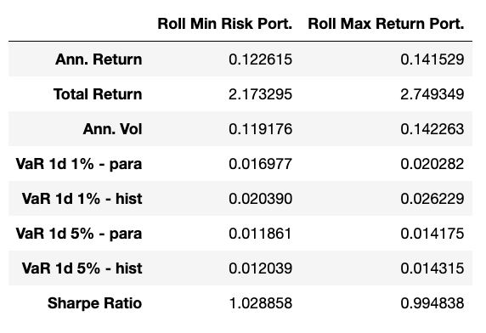
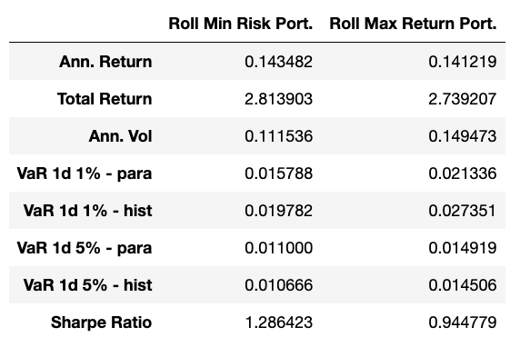
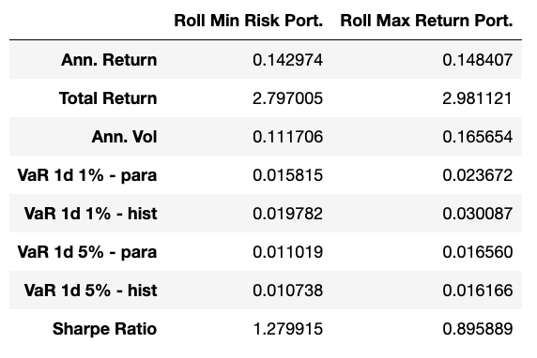
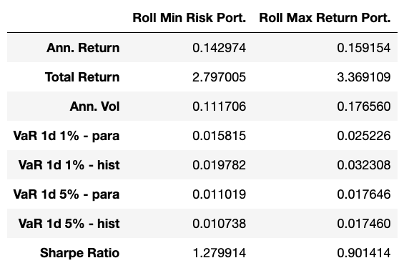
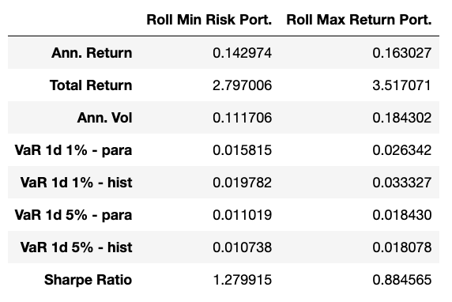
Strategy Tuning – Shorting Effect
No short selling: Bounds (0,1)
Limited short selling: Bounds (-0.25,1)
Moderate short selling: Bounds (-0.5,1)
Aggressive short selling: Bounds (-0.75,1)
Full short selling: Bounds (-1,1)

Slide 22
Observation – Shorting Effect
Impact on Volatility: Volatility increases as the level of allowed short selling increases from no short selling to full short selling. This trend is consistent across all short selling levels, suggesting that the introduction and increase of short positions contribute to higher portfolio volatility.
Impact on Total Returns: Total returns increase as more aggressive short selling is permitted, with the highest returns observed in the full short selling strategy. This indicates that greater short selling capabilities can potentially enhance the total returns of a portfolio.
Impact on Annual Returns: However, the annual returns show a more varied trend. While moderate short selling improves annual returns compared to no short selling, the most aggressive strategies do not always lead to the highest annual returns, suggesting diminishing returns or increased risk impacting returns as short selling becomes more aggressive.
Sharpe Ratio Trends: The Sharpe ratio is generally higher in scenarios with moderate short selling but decreases in more aggressive short selling strategies. This indicates that the increase in returns does not proportionally compensate for the increase in risk at higher levels of short selling.
Value at Risk (VaR) Analysis: VaR metrics generally increase with the level of short selling allowed, indicating higher potential losses in worst-case scenarios. This is consistent across both parametric and historical VaR calculations. Notably, while VaR metrics show an increase, the proportionate increase in risk does not always correlate with the increase in returns, particularly under full short selling conditions.
Risk Profile Concerns: As short selling levels intensify, so does the risk, as reflected by rising VaR metrics across more aggressive short selling strategies.
Recommendation on Short Selling: It is advisable to limit or avoid short selling to maintain lower volatility, manage risks prudently, and ensure more stable returns. This strategy minimizes exposure to extreme market downturns and balances return against risk effectively.

Slide 23
Strategy Tuning – Risk Management
Objective of the Study: Investigate the effectiveness of risk control strategies in managing portfolio volatility and returns over a decade-long period (2010-2020). The study focuses on understanding how implementing or foregoing risk controls affects the stability and growth potential of investment portfolios.
Methodological Approach:
Data Selection: Utilizes historical financial data spanning 2010 to 2020, analyzing different market conditions and their impact on portfolio performance.
Metrics Evaluation: Employs key financial metrics such as annual and total returns, volatility, Sharpe ratio, and Value at Risk (VaR) for a comprehensive assessment of portfolio behavior under varied risk strategies.
Triggering Risk Control: As the portfolio is monitored over time, each day's returns are compared against a predefined threshold. If the return is below this threshold, a 'strike' is recorded. Risk control measures are triggered once the number of consecutive 'strikes' reaches a set limit, prompting immediate portfolio adjustments to mitigate risks.
Rebalancing After Strikes: After a risk control event is triggered, the next step involves finding the appropriate rebalance index where portfolio adjustments can be made. These adjustments might include zeroing out percentage changes to stabilize the portfolio and prepare it for a more comprehensive rebalance at the identified index. This interim stabilization helps manage the risk by potentially nullifying the effect of adverse market movements leading up to the rebalance.

Slide 24
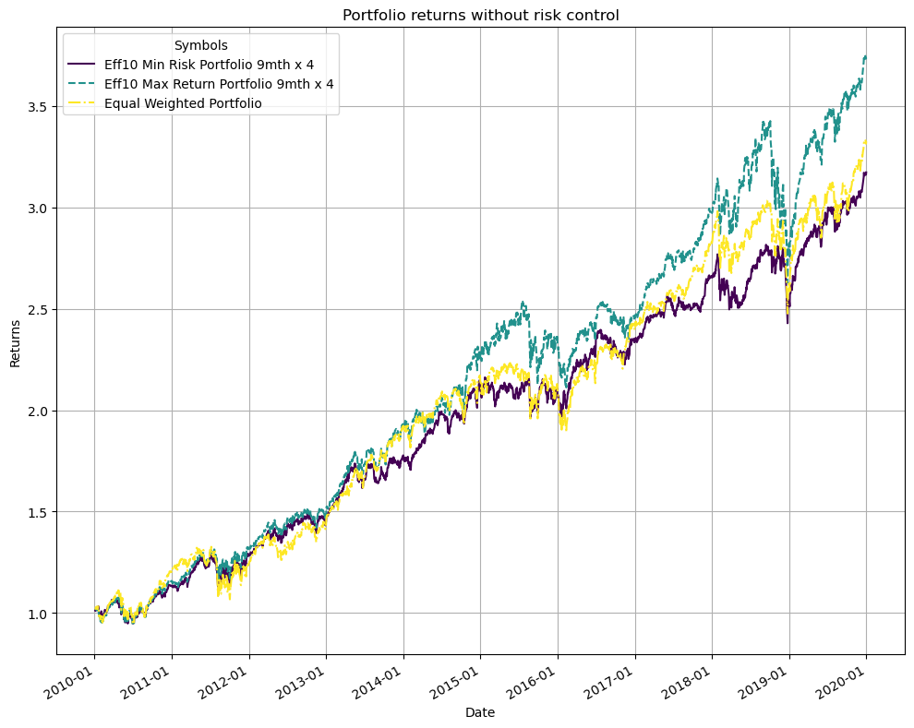
Strategy Tuning – Risk Management
Comparison of three investment portfolios from 2010 to 2020 focusing on their returns without risk control mechanisms.
Portfolios Analyzed:
Eff10 Min Risk Portfolio 9mth x 4: Targets minimum risk, adjusted every 9 months, possibly leveraged.
Eff10 Max Return Portfolio 9mth x 4: Aims for maximum returns, similar rebalance and leverage strategy.
Equal Weighted Portfolio: Maintains equal investment weights across all assets, periodically rebalanced.
Key Observations:
Maximum Returns: The Max Return Portfolio shows the highest growth, peaking above a 3x return by 2020.
Moderate Growth: Both the Min Risk and Equal Weighted Portfolios exhibit more conservative growth, with the Min Risk slightly underperforming the Equal Weighted until 2016, then closely matching or slightly outperforming it.
Market Sensitivity: All portfolios experienced volatility, particularly noticeable around 2015 and late 2018, reflecting market downturns or corrections.
Implications for Investors:
The data provides insights into how different risk profiles affect long-term investment returns.
Useful for evaluating investment strategies based on historical performance and market response.
Assists in making informed decisions regarding asset allocation and risk management in portfolio design.

Slide 25
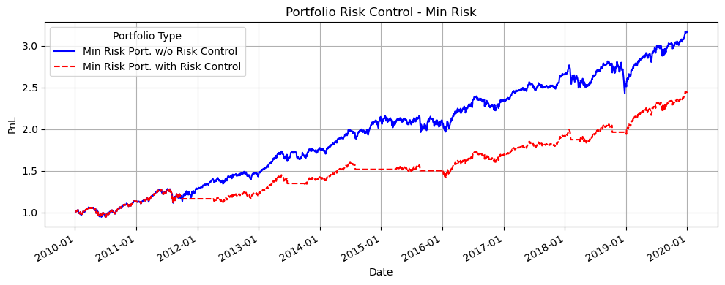
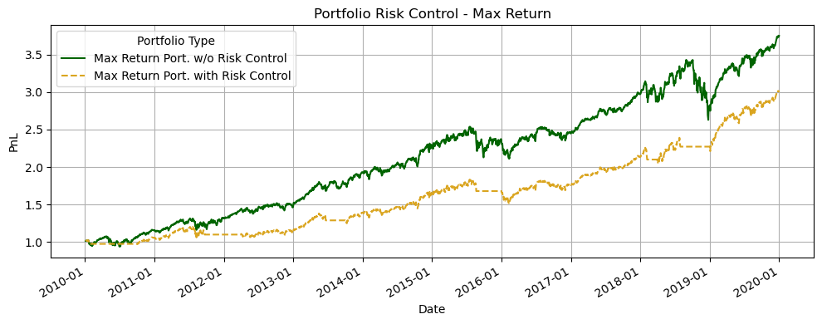
Strategy Tuning – Risk Management
Comparison of Portfolio Performance with and without Risk Control
Minimum Risk Portfolio (Top Graph):
Observation: Portfolio without risk control (blue) achieves higher growth compared to the risk-controlled portfolio (red), which shows more consistent but lower performance.
Insight: In low-risk strategies, omitting risk control measures might lead to better returns, suggesting a trade-off between stability and potential gains.
Maximum Return Portfolio (Bottom Graph):
Observation: The absence of risk control (green) results in higher returns with significant volatility compared to the steadier growth of the risk-controlled portfolio (yellow).
Insight: For high-return strategies, forgoing risk control can yield greater profits but also exposes the portfolio to greater risk and potential for sharp declines.
General Conclusion:
Risk Management: The effectiveness of risk control varies by strategy and desired outcomes; it can limit upside potential in exchange for reduced volatility and more predictable performance.
Investor Strategy: Decision on implementing risk control should align with investor risk tolerance and investment horizon, balancing between growth and stability.

Slide 26
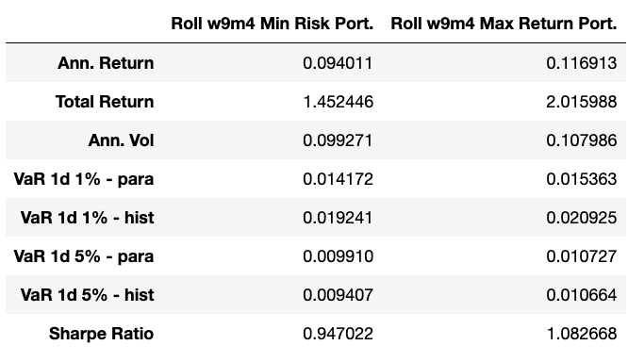
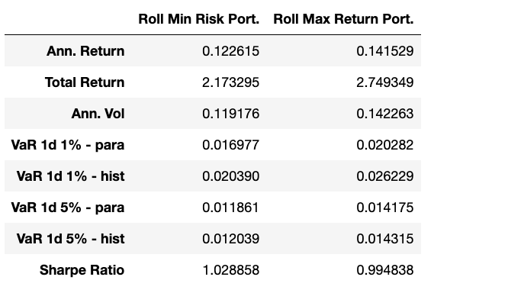
Strategy Tuning – Risk Management
With Risk Control
Performance Comparison: With vs. Without Risk Control:
With Risk Control (Upper Table):
Slightly lower returns but reduced volatility and VaR, indicating effective risk mitigation.
Ideal for conservative investors focusing on risk reduction.
Without Risk Control (Lower Table):
Increased returns signaling higher risk and reward.
Higher volatility and VaR point to a greater risk of substantial losses.
Risk Management Insights:
Demonstrates the effectiveness of risk control in managing downside risks and stabilizing returns.
Highlights the trade-offs between risk and return, essential for strategic investment planning.
Strategic Implications:
Necessity of aligning portfolio strategies with investor risk tolerance and investment objectives.
Discuss the importance of considering both the risk and the potential returns when choosing an investment strategy.
Without Risk Control

Slide 27
Observation – Risk Management
Value-at-Risk from In-sample performance
With 2-strike VaR control, risk metrics are enhanced
Without risk control, Max Return Portfolio significantly higher

Slide 28
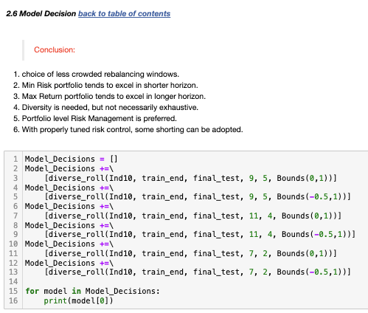
Summary - Model Decision
Optimizing Portfolio Management through Model Decisions
Code Implementation:
The Model_Decisions list dynamically adjusts strategies based on specific conditions to optimize portfolio performance.
Configures multiple portfolio strategies using the function diverse_roll, which is designed to adjust portfolio based on specified parameters and bounds.
Employs variations in rebalancing frequency (9, 11, 7 months) and risk bounds (0 to 1 and -0.5 to 1) to cater to different market conditions and risk appetites.
The diverse_roll function calculates portfolio performance with given constraints (rebalancing period and bounds), indicating a focus on diversifying risk and optimizing returns.
Key Conclusions:
Rebalancing Strategies: Opt for less crowded rebalancing windows to enhance returns.
Risk Evaluation: Minimize risk portfolios for short-term horizons; maximize returns over longer horizons.
Diversification: Essential but should be strategically targeted rather than exhaustive.
Risk Management: Diversified risk management is preferred, allowing for the adoption of shorting strategies under controlled risk.
Strategic Implications:
Effective rebalancing and risk control strategies significantly impact portfolio stability and growth.
Strategic diversification and risk management enable aggressive tactics like short selling within safe bounds.

Slide 29
Conclusion
Pre-covid strategy on post-covid portfolios for US industry portfolios do not necessarily perform well
Equal-weighted portfolio have robust performance, with limitation in deployment
Extreme strategy weights should be avoided, as there are max estimation errors
Final strategy:
Training period : Using historical data from 2010 -2020
Rolling window: 7 month x 2
Diversification: 10 industries
Shorting: no shorting
Risk control: no risk control
Notes:
1. Pre-covid strategy on post-covid portfolios for US industry portfolios do not necessarily perform well
Explanation: This conclusion suggests that strategies developed before the COVID-19 pandemic may not be effective in the post-COVID period due to changes in market dynamics.
2. Equal-weighted portfolios have robust performance, with limitation in deployment
Explanation: Equal-weighted portfolios (where each asset in the portfolio is assigned an equal weight) often provide robust performance due to their simplicity and diversification benefits. However, they may have limitations, such as higher transaction costs or difficulties in maintaining equal weights over time.
3. Extreme strategy weights should be avoided, as there are max estimation errors
Explanation: Portfolios with extreme weights (either very high or very low) are more prone to estimation errors. These errors can lead to significant deviations from expected performance.
Connection to Code:
The optimization process may sometimes suggest extreme weights to achieve the desired risk-return profile.
By setting bounds in the optimization process (Bounds(0,1) or Bounds(-1,1)), the code tries to avoid extreme weights.
Performance metrics and Value-at-Risk (VaR) calculations help in identifying and avoiding strategies with extreme weights due to high estimation errors.

Slide 30
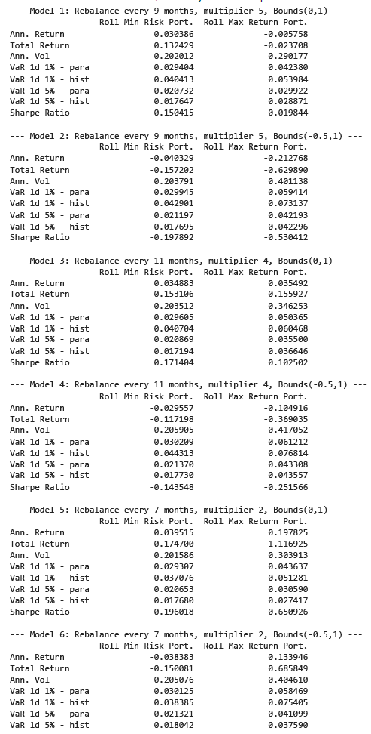
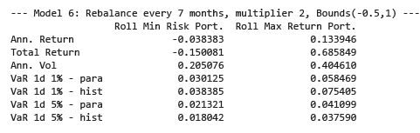
Model - Rebalancing every 7 months, multiplier 2, bounds (0,1)

Slide 31
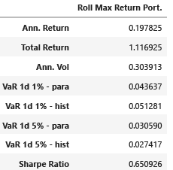
Final model with tuning vs w/o tuning
Notes:
Final model, no risk control, compare with vanilla, from jenn's slide, change without actual

Slide 32
APPENDIX

Slide 33
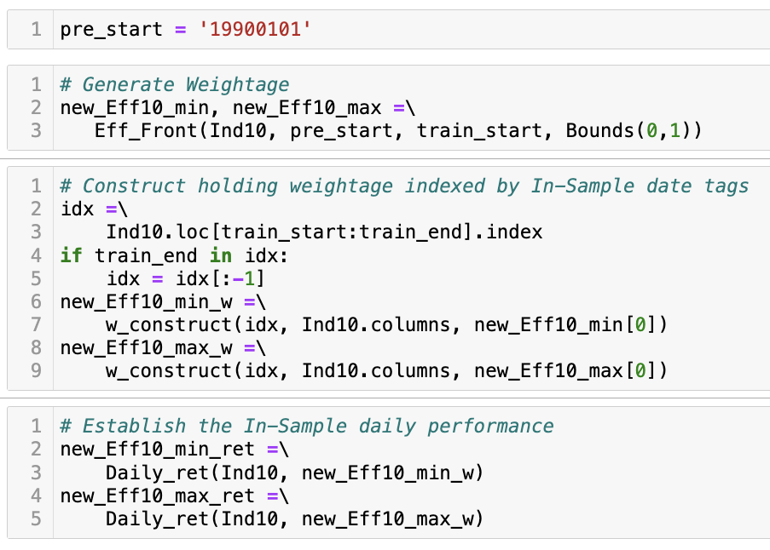
Strategy Tuning – Historical Data (Code Ref)
Generating Weights for Efficiency Frontier:
Utilizes historical data between 1990-01-01 to 2010-01-01
to calculate optimal portfolio weights aims to either minimize risk or maximize returns.
Applies constraints such as weights summing to 1, and each weight within the 0 to 1 range.
Construct Holding Weights:
Constructs weights for the portfolio using in-sample dates.
Ensures date continuity in the transition from the training end.
Establish In-Sample Daily Performance:
Calculates daily returns for portfolios with minimum risk and maximum return weights.
Uses previously determined weights for performance evaluation.

Slide 34
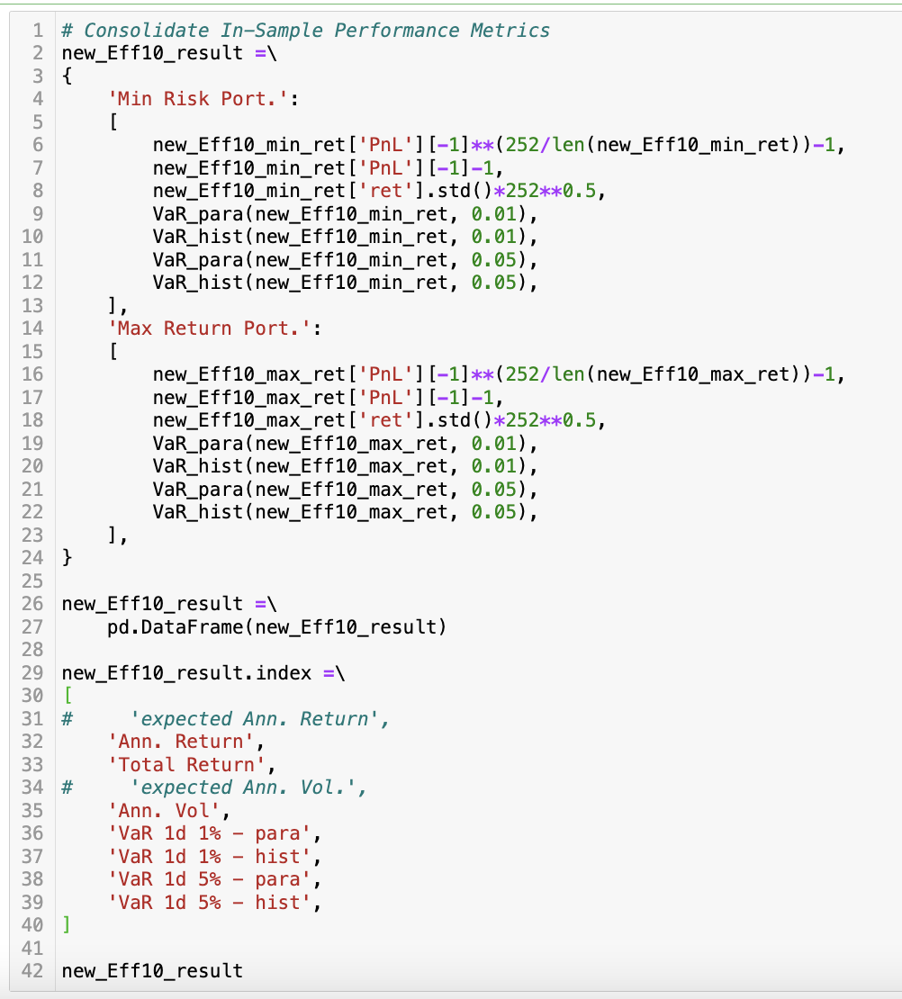
Strategy Tuning – Historical Data (Code Ref)
Consolidation of In-Sample Performance Metrics:
Generates a structured dataset (new_Eff10_result) from in-sample performance calculations.
Includes two portfolio types: Minimum Risk Portfolio and Maximum Return Portfolio.
Performance Metrics Calculated:
Annualized Return: Derived by normalizing the last value of the Profit and Loss (PnL) series to an annual basis.
Total Return: Calculated as the change in the last value of the PnL series from the initial value.
Annualized Volatility: Computed as the standard deviation of the returns, scaled to an annual measure.
Value at Risk (VaR) Assessments:
Parametric and Historical VaR for 1-day at 1%: Measures the potential loss in value of the portfolios at a 1% confidence interval over a single day.
Parametric and Historical VaR for 1-day at 5%: Estimates the potential loss at a 5% confidence interval over a single day.

Slide 35
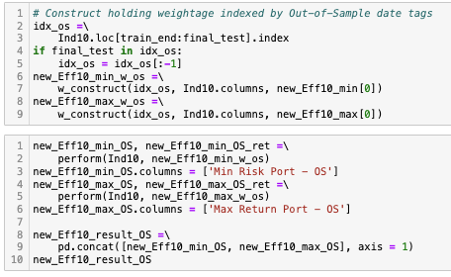
Strategy Tuning – Historical Data (Code Ref)
Construct Holding Weights for Out-of-Sample Period:
Extract the out-of-sample (OOS) dates from the dataset indexed from train_end to final_test.
Generate holding weights for the Minimum Risk and Maximum Return Portfolios using previously determined optimal weights (new_Eff10_min[0] and new_Eff10_max[0]).
Calculate Daily Returns for OOS Period:
Compute daily returns for both portfolios over the out-of-sample period using the Daily_ret function.
Store these returns in separate variables for further analysis (new_Eff10_min_OS_ret and new_Eff10_max_OS_ret).
Performance Metrics for OOS Period:
Evaluate the performance of each portfolio by calculating daily returns, which are then ready for further performance assessment or risk analysis.

Slide 36
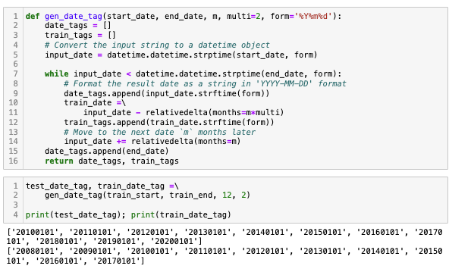
Strategy Tuning – Rolling Window (Code Ref)
Function: gen_date_tag
Purpose: Generates date intervals for testing and training in data analysis.
Key Features:
Input Parameters:
start_date, end_date - Define the analysis period.
n - Interval in months for generating date tags.
multi2 - Frequency multiplier for training tags.
form - Date format, default is '%Y%m%d'.
Process Overview:
Converts date strings to datetime objects.
Iteratively generates date tags spaced by n months.
Appends training dates every multi2*n months.
Includes final date in both test and training tags.
Output:
test_date_tags: List of dates for evaluating models.
train_date_tags: Dates for updating training data.

Slide 37
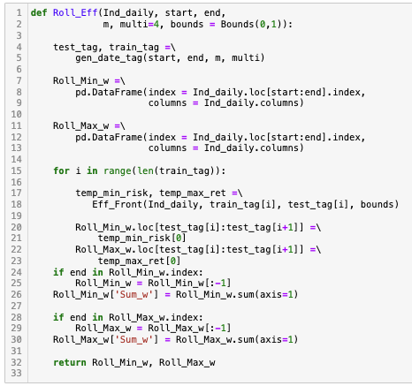
Strategy Tuning – Rolling Window (Code Ref)
Function: Roll_Eff
Purpose: Implements rolling window analysis for efficiency frontier calculations in finance.
Date Generation:
Uses gen_date_tag to create test_tag and train_tag for defining rolling windows.
Initialize DataFrames:
Roll_Min_W and Roll_Max_W - Stores minimum and maximum weights for each window.
Loop Operations:
Efficiency Calculation: Uses Eff_Front to calculate min risk and max return weights.
Assign Weights: Updates rolling window DataFrames with new weights.
Adjust Final Weights: If the end date is included, adjusts the final weights to include the last segment.
Output:
Roll_Min_W, Roll_Max_W - DataFrames containing the calculated weights for all rolling windows, facilitating easy comparison and back-testing against historical data.

Slide 38
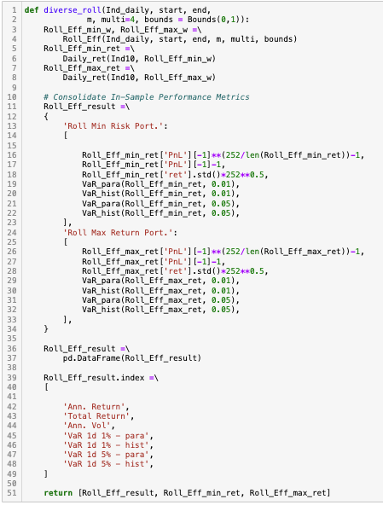
Strategy Tuning – Rolling Window (Code Ref)
Function Overview: diverse_roll_eff
Purpose: Calculates diversified portfolio metrics using rolling windows for financial data.
Core Functional Steps:
Efficiency Calculations:
Computes weights for minimum risk and maximum return portfolios.
Performance Metrics Calculation:
Calculates annualized and total returns.
Computes annualized volatility.
Evaluates Value at Risk (VaR) using both parametric and historical methods.
Loop through Windows:
Assign calculated weights to the rolling period.
Store calculated returns and risk metrics.
Compile Results:
Consolidates all metrics into a DataFrame (Roll_Eff_result).
Adjusts DataFrame indices for clarity and consistency.
Output:
DataFrames containing rolling metrics for minimum risk and maximum return portfolios.
A consolidated DataFrame of all performance metrics for each window.

Slide 39
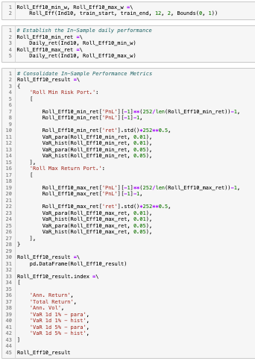
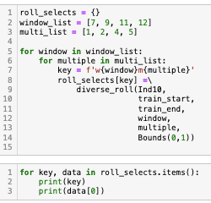
Strategy Tuning – Rolling Window (Code Ref)
Rolling Portfolio Performance Analysis
Purpose: Executes a comprehensive analysis of portfolio performance across multiple rolling window configurations to understand variability in financial metrics.
Rolling Analysis Execution:
Iterates through combinations of window sizes and multipliers.
Generates a unique identifier for each configuration.
Executes diverse_roll function to analyze portfolio performance for each set of parameters.
For Each Portfolio Configuration:
Minimum and Maximum Risk Portfolios: Calculates essential financial metrics such as annualized return, volatility, and VaR at 1% and 5% levels using both parametric and historical methods.
Consolidation of Results: Gathers and stores performance data in roll_selects for detailed analysis.
Output and Data Presentation: Structures all performance metrics in a comprehensive format for each window and multiplier combination.
Output:
Offers deep insights into how portfolio performance metrics vary with changes in window size and frequency of training, aiding in robust decision-making and strategy formulation.

Slide 40
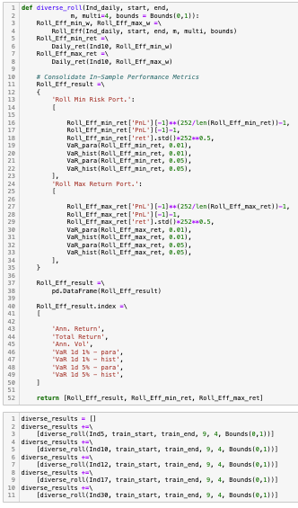
Strategy Tuning – Diversity Effect (Code Ref)
Impact of Industry Diversification on Portfolio Performance
Purpose: Examine how industry diversification influences portfolio performance metrics over varying rolling windows.
Rolling Analysis Setup:
Utilizes a dynamic approach to assess performance across multiple industry portfolios in different market conditions.
Performance Metric Calculations:
Minimum Risk and Maximum Return Portfolios:
Calculates critical metrics such as annualized return, volatility, and Value at Risk (VaR) for portfolios diversified across industries.
Data Structuring:
Results for each configuration are consolidated in Roll_Eff_result, facilitating easy comparison.
Dynamic Configuration Loop:
Iterates through combinations of window sizes and multipliers to assess the effects of varying temporal scopes and sensitivity levels on the portfolio performance.
Each iteration re-evaluates portfolio metrics under a new set of conditions to gauge the stability and performance of diversified portfolios.
Results Collection and Output:
Collects and stores performance data for each configuration in diverse_results, providing a rich dataset for analysis.
Allows for an in-depth assessment of diversification benefits and risks across different industry sectors and time frames.
Output:
Delivers valuable insights into how industry diversification impacts portfolio risk and return characteristics over time.
Supports strategic decision-making by highlighting optimal diversification strategies based on historical performance and market variability.

Slide 41
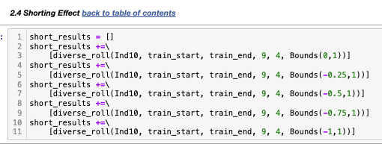
Strategy Tuning – Shorting Effect (Code Ref)
Analyzing the Shorting Effect on Portfolio Performance
Purpose: Assess how allowing short selling influences portfolio metrics across various thresholds.
Short Selling Constraints:
Explores a range of short selling limits by adjusting the bounds in the optimization:
No short selling: Bounds (0,1)
Limited short selling: Bounds (-0.25,1)
Moderate short selling: Bounds (-0.5,1)
Aggressive short selling: Bounds (-0.75,1)
Full short selling: Bounds (-1,1)
Diverse Roll Function:
diverse_roll function called with different bounds to simulate various levels of short selling.
Each call represents a unique scenario, testing how negative weights (short positions) impact the risk-return profile.
Aggregation of Outcomes:
Results from each scenario are collected into the short results list.
Provides a comparative view of performance metrics across different short selling strategies.
Output:
Offers valuable insights into the risk and return trade-offs associated with short selling.
Aids in formulating more nuanced investment strategies that incorporate short selling to enhance performance and manage risk.

